Slide 1

Influenza Staffing Season Case Study
Haley Bustle
August 2023

Slide 2
Project Tools and Resources
Project duration: Eight weeks
Project resources
US Census Bureau – website containing estimate population counts by state, county, year, gender, and age group
CDC Wonder – website containing all death reports in the U.S. for a specific time frame. Allows you to create a custom dataset based on certain factors (in this case, deaths by state, gender, number of influenza deaths by age group)
Tools Utilized
Microsoft Office: Word for project summary, data description, final report; Excel for data analysis, cleaning, integration, and visualizations and final report
Tableau Public: creation of visualizations and final story board presentation

Slide 3
Project REFERENCES AND data SOURCES
Dataset 1, Influenza Deaths, 2009 – 2017
Dataset 2, U.S. Census Population Estimate, 2009 – 2017
Final Report available on GitHub
Final Tableau Storyboard
Tableau Visualizations
Please note, not all visualizations created were used in the final project

Slide 4
What is the influenza staffing project?
Immersive project adopting new tools using only Excel to clean and analyze data
The aim of the project was to help a fictious medical staffing agency prepare staff distribution for the upcoming 2018 flu season
Past data provided is census estimate populations and reported influenza deaths between 2009 and 2017
Project objective is to help the agency understand where to send staff
Analyze data to gain insights on which states have highest reported deaths and which age group is “vulnerable” and has the most reported deaths

Slide 5
Project challenges
Project success was contingent on preparing a final report to determine when to send staff and how many to each state
Number of staff at this company was not provided; created challenge in providing a complete report of how many staff to send to each state
Public health data can be unreliable
reports of deaths can go unreported due to number of reasons, including but not limited to: socioeconomic restrictions, human error (forgotten or mislabeled death report), privacy of victim, private hospitals not obligated to report
Influenza is an unpredictable illness
Infection season can last longer or shorter each year, causing a varied report of deaths
Influenza symptoms can be misdiagnosed or death by another illness could be counted instead of influenza, skewing the numbers

Slide 6
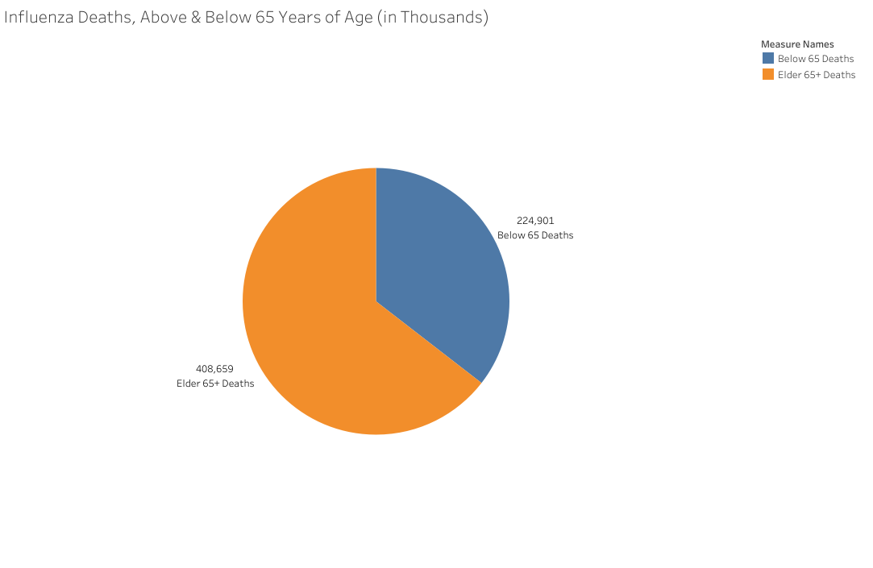
Project insights: Identifying and studying the hypothesis
Identified the vulnerable population to be those over 65 years of age
Hypothesized that states with larger populations will have larger reported deaths in the vulnerable age group
Studied first if this group is in fact at risk and has more reported deaths
Results determined more than half of reported deaths to be those 65 years or older

Slide 7
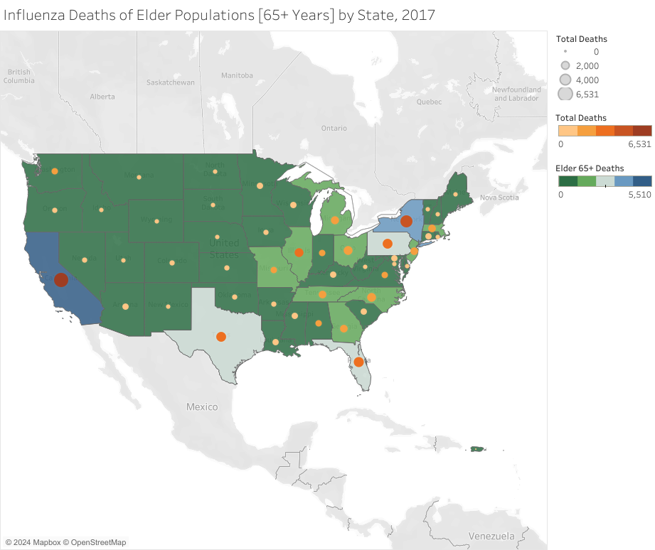
Project insights: Resource allocation
Determined states with higher populations had higher reported total deaths and vulnerable population deaths
California had over 6,531 total deaths reported, of which 5,510 were individuals 65y+ between 2009 and 2017
Without staff numbers, created an interactive map using this map shown
Map classified states in high, medium, and low priority of staff need based on reported deaths in relationship to the total population
California, Texas, Florida, Pennsylvania, and New York were classified High Priority, for example

Slide 8
Project conclusions and remarks
Project & Analysis Challenges
Number of staff was not provided, posing a challenge in presenting a precise allocation recommendation
Dataset provided on influenza deaths is largely suppressed (54,000 variables out of 66,000), meaning the reports for deaths are equal or less than nine, impacting the accuracy of the study
Suppressed values were randomized (b/w 0 and 9) for practical study, but do not accurately represent the number of deaths
Datasets for this study are at least seven years old, and total death reports, total population counts, and collection methods may have changed which can impact the results of a study
Analysis Development
Identified company need for development of flexible staffing model to adapt to changes in sudden need for increased or decreased staff
Recommend internal data collection to determine if staffing recommendation changes were positive, neutral, or negative to make necessary adjustments
Identified better need of data collection and reporting process for deaths related to influenza

Slide 9

Thank you

